Slide 1







Our Backgrounds & Affiliations
Change Uni logos, etc.
Future Collaborators
Future Funding & Support

Slide 2
Outline
Our Backgrounds, Affiliations & Past Projects...
The Topics of Research Interest, How they are connected to Past Projects, Why its important & Why the timing is good, Why Uruguay (Biophysics of Sound, Systems Biology of Regenerative Medicine)
Public & Media Interest (Global Awareness & Student Enrollment)
WHAT (i.e., Studies/Projects) Therapeutic Instruments & Metabolite/Microbiome Screening – Differential Diagnosis & Physician Treatment Support
HOW (i.e., Experiential Learning, International Students & Citizen Science)
Other possible collaborators (Chile, UCSD, Toyota...)
Possible Funding Sources (Patricia, ....)
University Benefits
What do we need from YOU (A University Appointment, Association, etc...)

Slide 3
Conceptual Story
Healthspan vs Lifespan and the growing gap (living longer but not healthier)
The role of modifiable SDOH factors from a broader perspective
How much does healthcare help and can it change to improve effectiveness?
Interconnected systemic factors & feedback loops drive emergence of observable phenotypes.
Strategic modeling and examples of successful implementations (i.e., EBAIS Teams in CR)
Research to Practice Framework
Neural Endocrine Immune Networks & Vagal Nerve Mediation of Inflammatory Pathways
Sound modality & treatment protocols

Slide 4
Neural Endocrine Immune Metabolic Networks (MIEN)
Nerves
System
Neuroregulators
Neuroregulators
Hormones
Immunoregulators
Metabolic
Action
Endocrine
System
Gut
System
Hormones
Immunoregulators

Slide 5
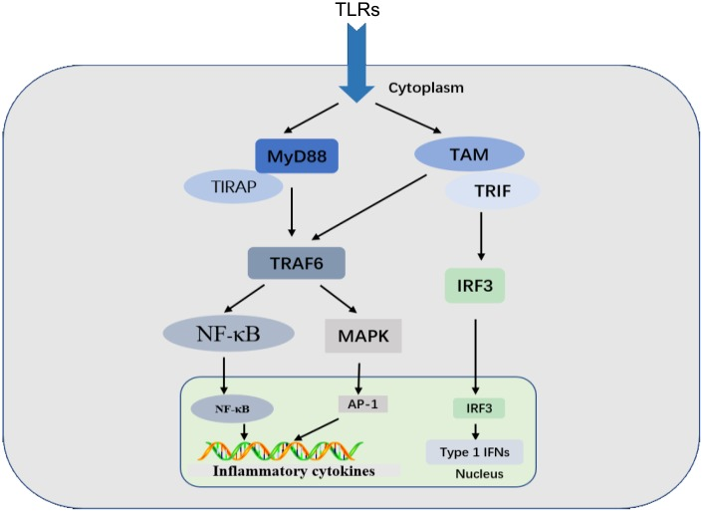
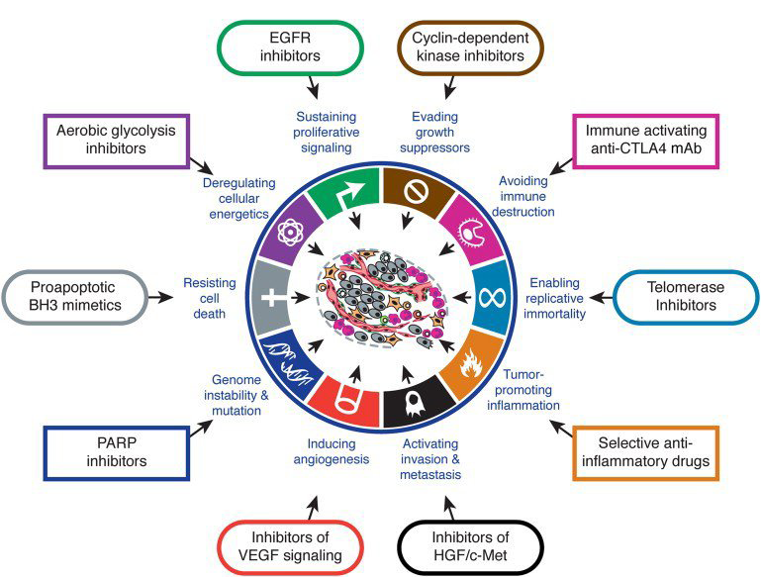
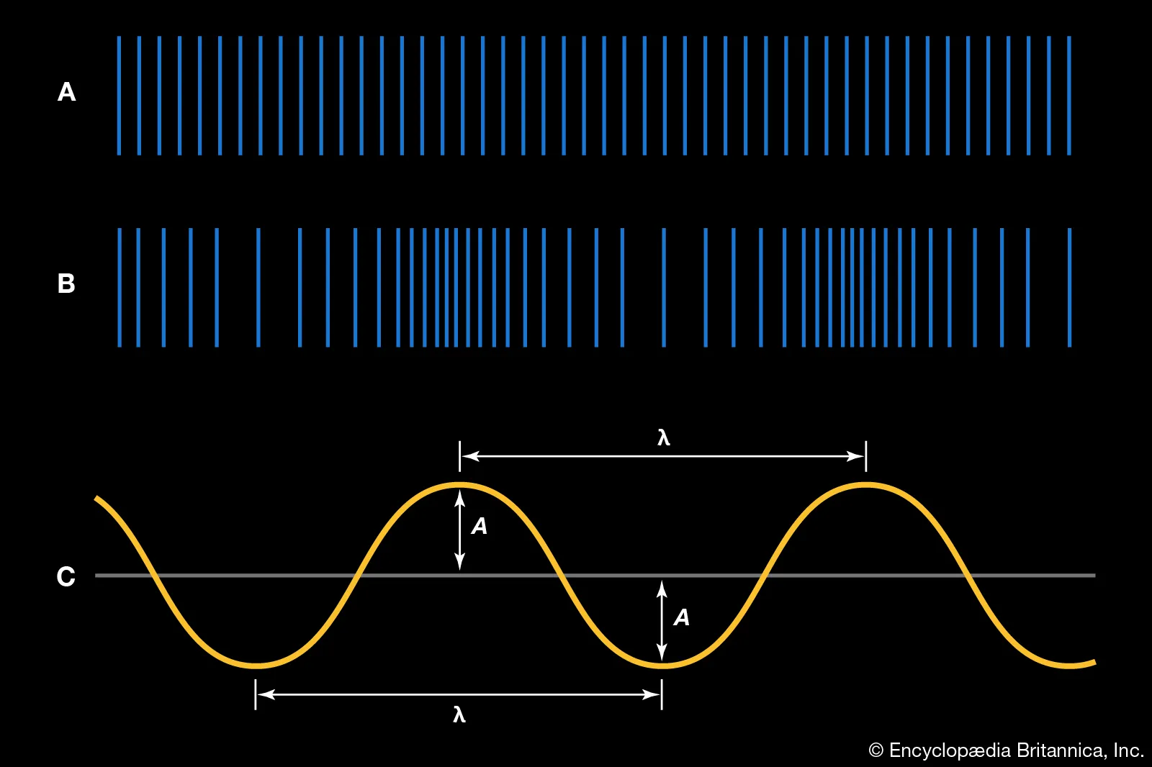
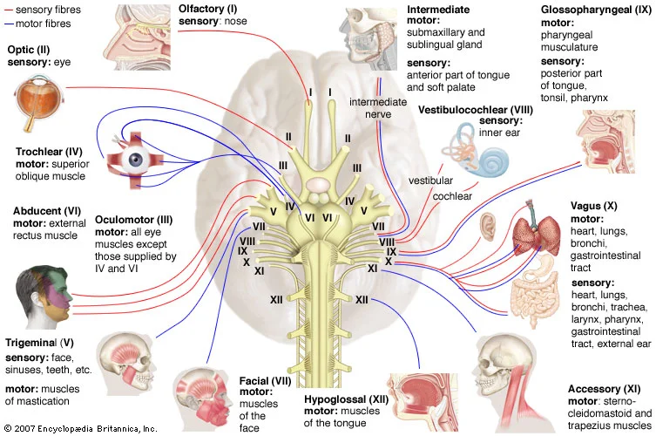
Vagus Nerve & PNS Activation
Vagus Nerve Activation
Higher PNS Activity
Inflammatory Pathways
Cell Regeneration
Chronic Disease Pathways
Neural, Endocrine, Immune Nets
Mood Inventories (HADS, ??, SAI)
HF HRV -> Higher Valgal Tone | PNS
EEG Alpha Power Band Reduction -> “theta & alpha hypothesis”
Desynchronization of Alpha Activity
Sound Sensitive Receptors
Sources: UCSD, Salk Institute, MIT, …

Slide 6
Conceptual Story
Establish relationship between sound harmony patterns & brain wave stimulation
Establish relationship between brain wave patterns & relaxation response
Establish relationship between Vagus Nerve & Cell Regeneration (Healing)
Characterize Vagus Nerve Stimulation Modalities & their metabolite actors
Map chronic disease states & Vagus Nerve Modalities in Healthy & Comorbid Cohorts

Slide 7
U of M Benefits
We bring in potential international students for degrees there.
International student exchange program with U.S. universities.
Affiliations with UCSD, potentially Claremont Graduate University, U. of Louisville, Earth University, U of CR, etc.
On-site practical (hands-on) experience for students: in the field and in the lab.
Students will like to come to Punta del Este area (beaches, nature, etc.)
No cost to U of M.
Won’t use up valuable lab space at campus.

Slide 8
Our Focus Areas
Tamara: Science of Biophysics of Sound on the Human Body
Connection with Uruguay: Toyota’s Harmony Project.
Connection with South America: Chile Research
Lab equipment: We have EEG/EKG, microscope, high-powered computer. Will get centrifuge.
Timeline: Our bowls articles, stress paper (systems theory, pandemic of stress), Mike paper, papers I’ve co-authored w/ Spain (cancer, etc.)
Vagus nerve.
Public interest & media attention now on our work on the benefits of sound therapies (CNN, etc.)
Our lab: Institute of Integrative & Regenerative Medicine.
Funding: local support for lab (Patricia’s funders from Argentina); potential US grants/funding.

